Slide 1

Project-Based Learning as an Effective Teaching Method in Physics (Science)
Markus Hitila |NUST
TEACHERS INFORMATION SEMINAR
03/10/2022

Slide 2

PRESENTATION OUTLINE
Introduction
Teaching Methods
Project Based Teaching and Learning PBL
Steps to effective project-based learning
Conclusion

Slide 3
Introduction
In Namibia, the teaching of science, technology and mathematics (STEM) is being prioritized to speed up its economic development
The current Namibian educational policy fosters the teaching of sciences as a means towards building a knowledge-based economy.
However, effective teaching and learning of science in general, and physics has encountered challenges in recent decades.
The lack of sufficient infrastructure and equipment coupled with curriculum changes and noticeable lack of sufficient science teachers are some of the key factors affecting effective learning
In addition to these factors, it is generally observed that the teaching and learning of science (including physics) in Namibia is still dominated by teacher-cantered approaches that do not promote students 'active learning.

Slide 4
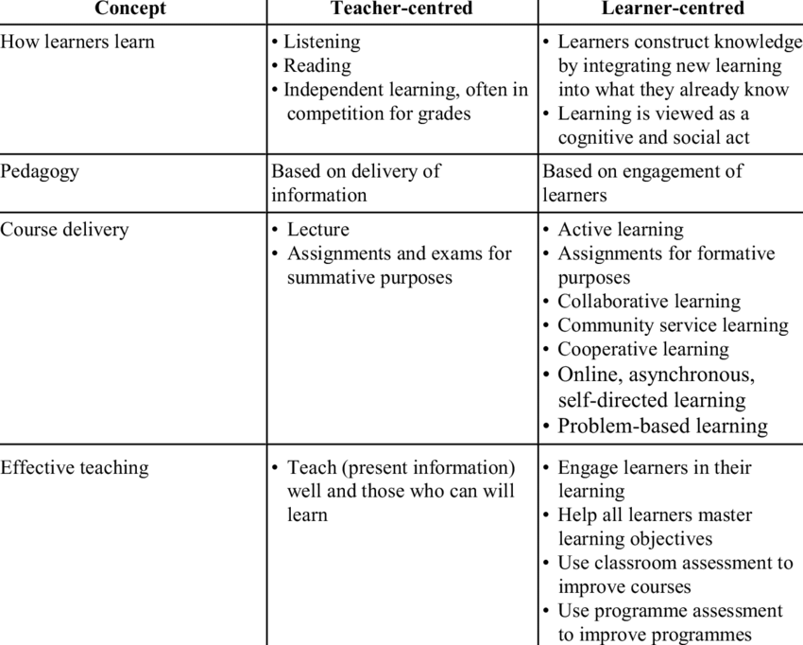
Teaching Methods
To optimize the achievement of learners, teachers need to use variety of teaching methods.
Factors affecting the performance in Physics
lack of appropriate teaching materials and qualified teachers,
traditional teaching methods,
lack of mathematics skills,
student epistemologies and misconceptions
The physics instruction approaches

Slide 5
Project Based Teaching and Learning
Project-based learning (PBL) is an inquiry-based educational approach in which students explore real-world problems through individual and group projects. This teaching and learning method encourages students to make sense of why content is useful and how it might be applied.
Project-based learning is one of the effective student-centered learning methods.
Today’s education system is characterized by a gap between how students live and what they learn and how they learn.
Effective Project based Learning is characterized by:
a shift from whole-class to small group instruction,
a shift from lecture and recitation to coaching,
a shift from competitive to a cooperative social structure,
a shift from all students learning the same thing to different students learning different things.
Studies have illustrated that project-based learning in which students are particularly active contribute to meaningful learning
At its core, Learners can develop desirable characteristics such as:
Research skills,
self-confidence,
responsibility and
cooperation,

Slide 6
Key Design Principles of PBL
Purposeful & Authentic experience
Generated by learners by engaging in relevant questions (feasible to consider, worthwhile, contextualized, meaningful, and ethical)
Related to learners' lives, communities in which they reside, & real-world happenings.
Deep integration with subject content
Projects should feature deep integration with course content and be rooted in core subject areas, helping to deepen and build student knowledge of important topics
Meaningful & supportive relationships
Quality PBL benefits from collaborative peer-to-peer interactions and trusting student-teacher relationships.
Evidence-Based teaching & assessment practices
Learning from research and relying on evidence about what works is essential
providing feedback to students in a strategic and timely manner, creating opportunities for reflection, and empowering students to share their learning with others

Slide 7
When designing a PBL unit for your classroom,
it must contain a few basic components
TOPIC
Energy
THEME
Effect of energy crisis on people and
the environment
SCENARIO
Provide alternative energy sources & solutions to problems arising from fossil fuel
PROBLEM QUESTION
How do we minimize the impact of fossil fuel on the environment
STUDENT ROLE
Learners are members of the research Team
CULMANATING ACTIVITY
Learners present their assessments and alternative solutions models to panel of research committee

Slide 8
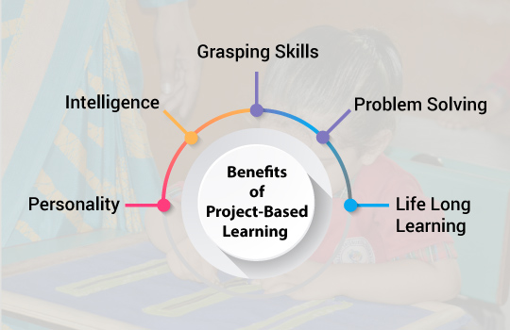
WHY PBL?
Give learners freedom to generate artifacts that are critical to their construction of knowledge.
Places Learners in realistic, contextualized problem-solving environments
Serve to build bridges between phenomena in the classroom and real-life experiences
Adaptable to different types of learners and learning situations, though requires active engagement of students’ effort over an extended period
An instructional methodology in which learners learn important skills by doing actual projects
Allow learners to apply core academic skills and creativity to solve authentic problems in real world situations
Based on the constructivist learning theory, which finds that learning is deeper and more meaningful when students are involved in constructing their own knowledge.
The teacher’s role is that of an academic advisor, mentor, facilitator, task master and evaluator

Slide 9
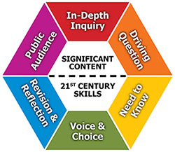
WHY PBL?
Can lead to the enhanced development of learners’ skills and beliefs such as:
group work skills, life skills, (managing meetings, planning, budgeting, etc.),
cognitive processing skills (decision making, critical thinking, problem solving, etc.)
self-management skills (setting goals, organizing tasks, time management, etc.) attitudes (love of learning, willingness to further education),
personal trends (self-direction, sense of accomplishment),
Beliefs (self-sufficiency)
Learners can significantly improve their scientific processing skills through:
questions,
discussions,
observations and
predictions,
conducting experiments,
collecting and analyzing data, and
ultimately reaching conclusions and sharing findings

Slide 10
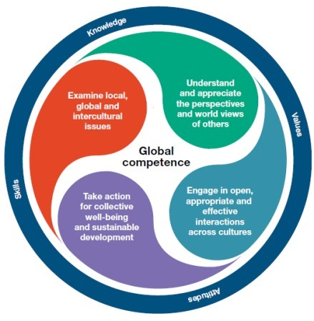
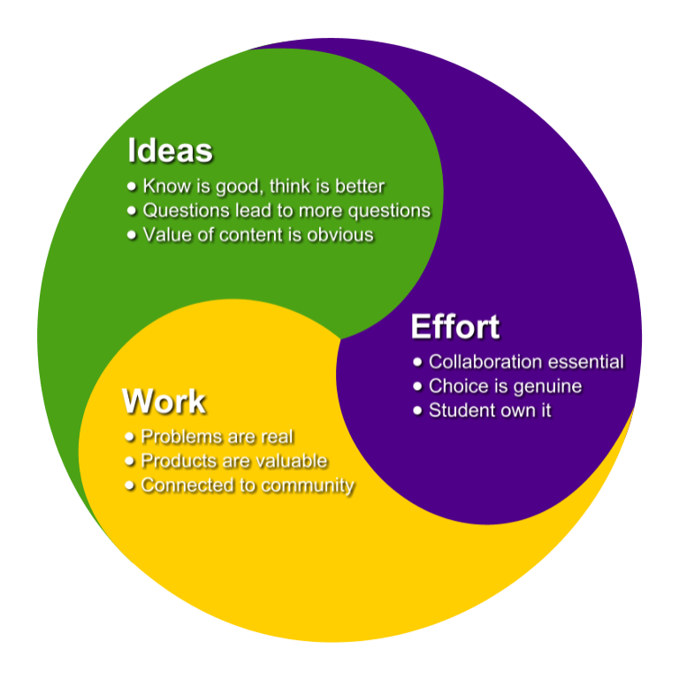
CONCLUSION
Rigorous project-based learning has a positive impact on students, leading to increased achievement and higher levels of motivation

Slide 11


